Slide 1
Weakly Supervised User Proﬁle Extraction from Twitter
Jiwei Li,Alan Ritter,Eduard Hovy
ACL 2014

Slide 2
Introduction
treated this as a classiﬁcation task where the goal is to predict unary predicates describing attributes of the user.
the lack of available training data.

Slide 3
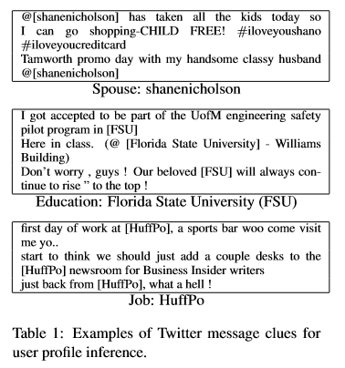
Introduction
user generated content often contains strong evidence to suggest many types of user attributes.

Slide 4
Related Work——Distant Supervision
weak supervision: an existing database as a source of supervision.
leverage readily available structured data sources as a weak source of supervision for relation extraction from related text corpora.

Slide 5
Related Work——Homophily
people sharing more attributes such as background or hobby have a higher chance of becoming friends in social media.
neighborhood context to boost inference accuracy.

Slide 6
Contribution
cast user proﬁle prediction as a binary relation extraction.
a large-scale dataset gathered from various structured and unstructured social media sources.
the beneﬁt of jointly reasoning about users’social network structure when extracting their proﬁles from text.
the effectiveness of our approach on 3 relations: SPOUSE, JOB and EDUCATION.

Slide 7
OUTLINE
Introduction & Related Work
Our Work
Dataset Creation
Model
Experiments & Results
Conclusion

Slide 8


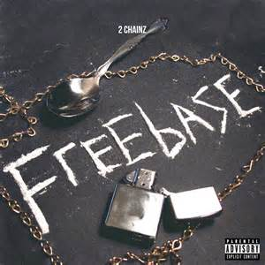
Database Creation

Slide 9
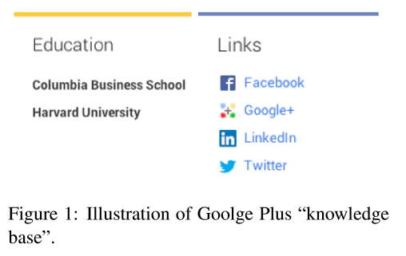
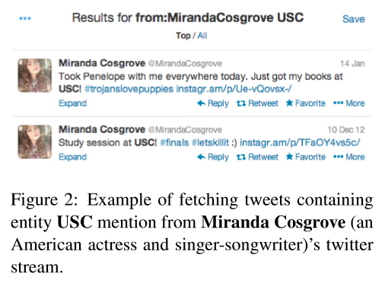
Database creation
seed users
Google Plus API
correspondent users
Twitter's search API
Freebase API(alias recognition)
twitter contents

Slide 10
Database Creation
assure friend identity
avoid name ambiguity
Twitter follower list
Google Plus Circle
new seeds

Slide 11
Dataset Creation——Spouse
REFLEXIVITY

Slide 12
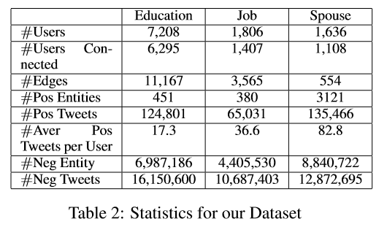
Dataset

Slide 13
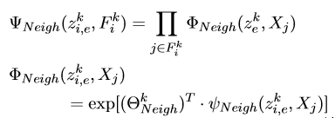
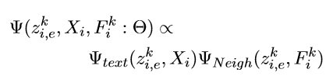
Model
twitter content
User
friends

Slide 14

Model——Inference
NEIGH-OBSERVED
NEIGH-LATENT
sieve-based greedy search approach.
initialized using only text features,maximizing ,ignoring networks information.
iteratively reestimate user's profile given both their text features and network features.

Slide 15
Baselines
Only-Text: network/neighbor inﬂuence is ignored. Classiﬁeris trained and tested only based on text features.
NELL: For Job and Education, candidate is selected as attribute value once it matches bag of words in the list of universities or companies borrowed from NELL.

Slide 16
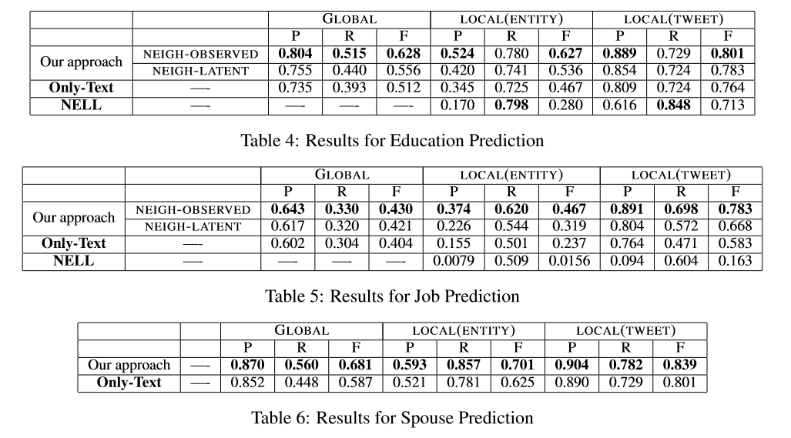
Result

Slide 17
Conclusion
cast user proﬁle prediction as a binary relation extraction.
a large-scale dataset gathered from various structured and unstructured social media sources.
the beneﬁt of jointly reasoning about users’social network structure when extracting their proﬁles from text.
the effectiveness of our approach on 3 relations: SPOUSE, JOB and EDUCATION.

Slide 18
THANK YOU.
2120151036 王丹
2016/3/17

